Slide 1

HBFC BANK
Rakesh Ranjan

Slide 2
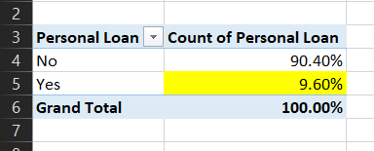
1. What percentage of the bank’s customers (according to the data) have availed Personal Loans?
I have done this using pivot table and uses the count function in values to find the no of people availed the personal loan and then I converted that into percentage and find the insights that 9.60% people have availed personal loan

Slide 3
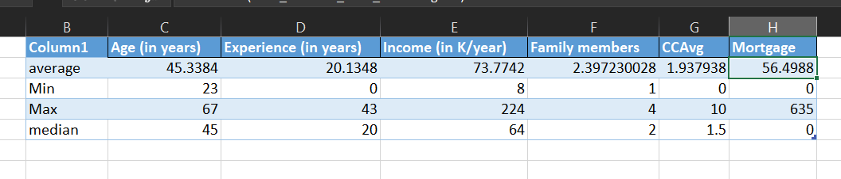
2. Generate a table with min, max, median & average for all numeric variables (age, experience, income, family members, CCAvg, Mortgage). What are your observations?
To find the min,max median and average for all numeric value , firstly I calculated all the values using all the functions and then just dragged down and replaces the function wuth the desired function I want for all the column

Slide 4
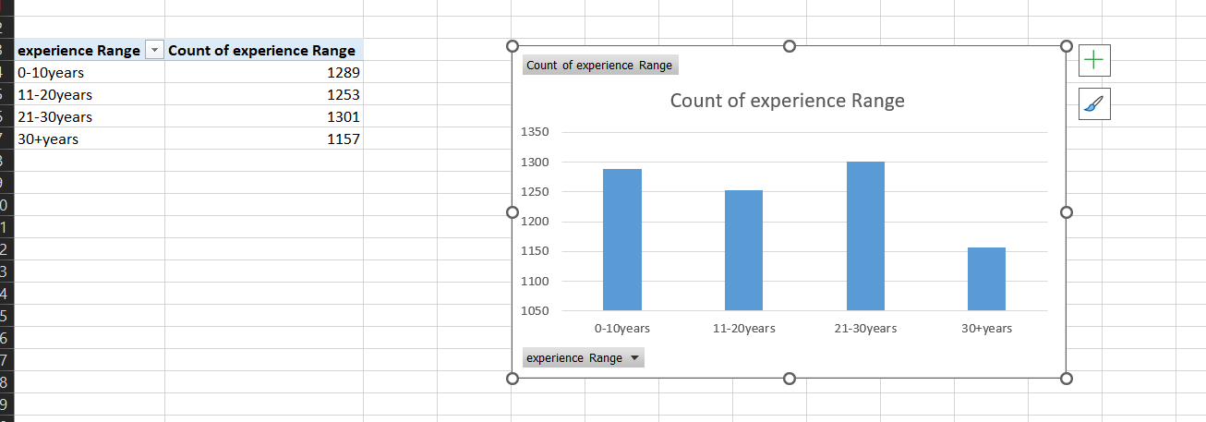
3. Create a new categorical variable for Experience using 4 categories – a. 0 to 10 years b. 11 to 20 years c. 21 to 30 years and d. 30+ years. Plot a bar graph for this new categorical variable
To achieve this I have inserted a column and used the if function to achieve this by using the formulae
=IF(D2<=10,"0-10years",IF(D2<=20,"11-20years",IF(D2<=30,"21-30years",IF(D2>30,"30+years"))))

Slide 5
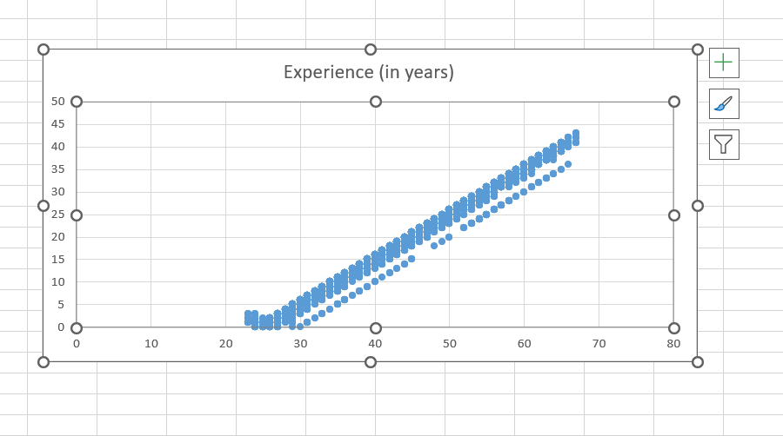
4. Create a scatter plot of the Age and the Experience variable. What do you observe?
To achieve this I have copied the age and experience variable in another sheet and created the scatter plot from which I have understand that age and experience are co-related with each other as the age is increasing experience is also increasing.

Slide 6
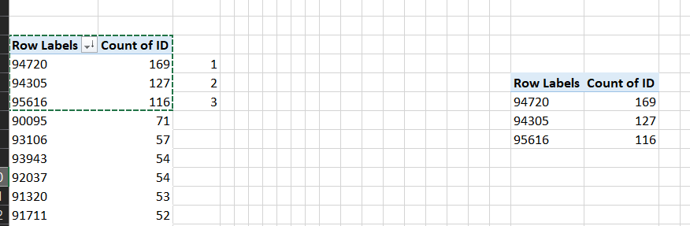
5. What are the top 3 areas (ZIP Codes) where the bank’s customers are located?
To achieve this I have used the pivot table to count the no id with zipcode and I have found the top three zipcodes

Slide 7
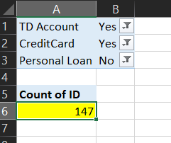
6. How many customers have a combination of Fixed Deposits and Credit Cards but not Personal Loan?
I have achieved this scenario using the pivot table and got the answer count of such customers is 147.

Slide 8
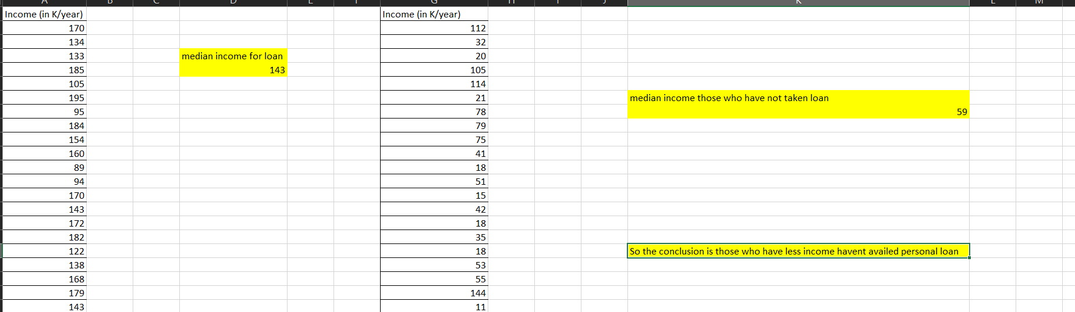
7. What is the median income of the customers who have availed personal loans and compare it with the median income of those customers who have not availed personal loans? What do you infer?
To achieve this I have copied the loan column and then used the filter option to filter that who has taken the personal loan and who has not taken the personal loan and then copied them in different sheet and the find out the median using the MEDIAN() function.

Slide 9
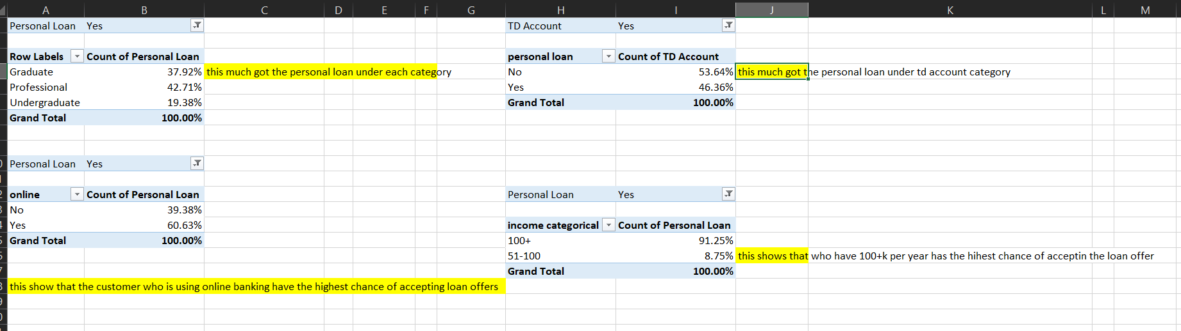
8. Create 4 separate Pivot Tables. Summarise your data by percentages. • Education vs Personal Loan • TD Account Vs Personal Loan • Online vs Personal Loan • Income_Category vs Personal Loa

Slide 10
To achieve this I have used the pivot table and created the 4 table
1. First table is education vs personal loan in which I have found out that professionals have accepted the most personal loan offer after that graduate and then undergraduate customers.
2. In second table I have taken Td account vs personal loan In which I have found out that those who have TD account in that only 46% have taken the personal loan
3. In third table I have taken online vs personal loan where I have found out that those who are using online banking services have in which 60% customers availed personal loan
4. In fourth table I have taken income categorical vs personal loan in which I have found that those customers who have the income range of 100k+ year from those customers 90% of them availed the personal loan

Slide 11
9. Analyse the Pivot tables created in the previous question and state any anomaly that you observe. Which categorical variables appear most important for your further study if you want to analyse which customers are most likely to take personal loans and why?
1. First table is education vs personal loan in which I have found out that professionals have accepted the most personal loan offer after that graduate and then undergraduate customers.
2. In second table I have taken Td account vs personal loan In which I have found out that those who have TD account in that only 46% have taken the personal loan
3. In third table I have taken online vs personal loan where I have found out that those who are using online banking services have in which 60% customers availed personal loan
4. In fourth table I have taken income categorical vs personal loan in which I have found that those customers who have the income range of 100k+ year from those customers 90% of them availed the personal loan

Slide 12
10. In the last campaign, bank reached out to 5000 customers out of which 480 customers accepted the personal loan offer. The bank incurred a huge cost in running a marketing campaign to reach out to so many customers. This is where you as a strategic business consultant step in. You are tasked to optimise the cost of this campaign by identifying the correct target base (without significant reduction in number of acceptance of offers). The bank can then send Personal Loan offers to these target customers who have a higher chance of accepting the offer. Based on your analysis, what strategy would you suggest to the management of HBFC bank?
So after analysing the data I came to know that the personal loan availed by the customer who fall in the income bracket of 100K+ year.
So if bank want to optimise the cost of campaign then they should target the customer who have the income of 100K+ year and uses online banking .

